Slide 1
Operating Systems
Dr. Deepak Dembla

Slide 2
Virtual Memory

Slide 3
Objectives
Need of Virtual Memory
Virtual addresses and virtual address space
Implementation of VM system through demand loading
Demand paging
Page replacement algorithms
Stack property of page replacement algorithms
Thrashing and its solutions
Paging hardware and its components
VM handler and its components

Slide 4
Virtual Memory
Virtual memory may be realized with paging or segmentation as it requires a non-contiguous memory allocation method.
All the basics related to these concepts apply here also in VM system.
The logical address here is known as virtual address and the logical address space is called as virtual address space.

Slide 5
Virtual Memory
The address translation using paging and segmentation are applied in the same way as discussed in the last chapter.
The only difference of applying paging and segmentation in relation to virtual memory is that there is no need to load the whole process in the form of pages or segments in the main memory.
VM system requires only those pages or segments of a process in the memory which are needed at a certain time of execution.

Slide 6
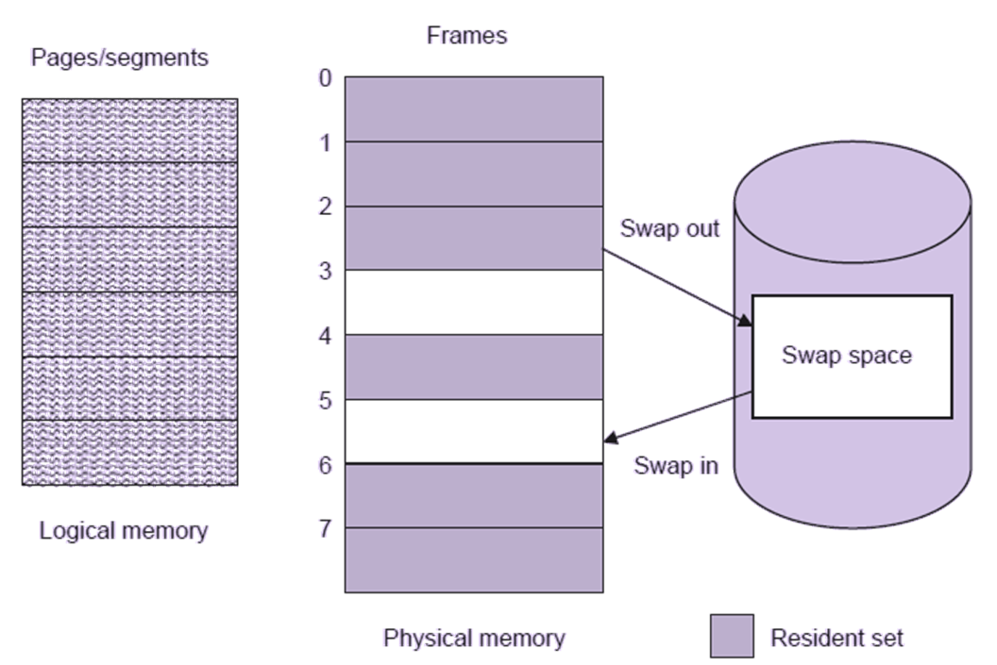
Demand loading

Slide 7
Demand paging
Demand paging is to load only those pages in the memory that are needed at an instant of time of execution.

Slide 8
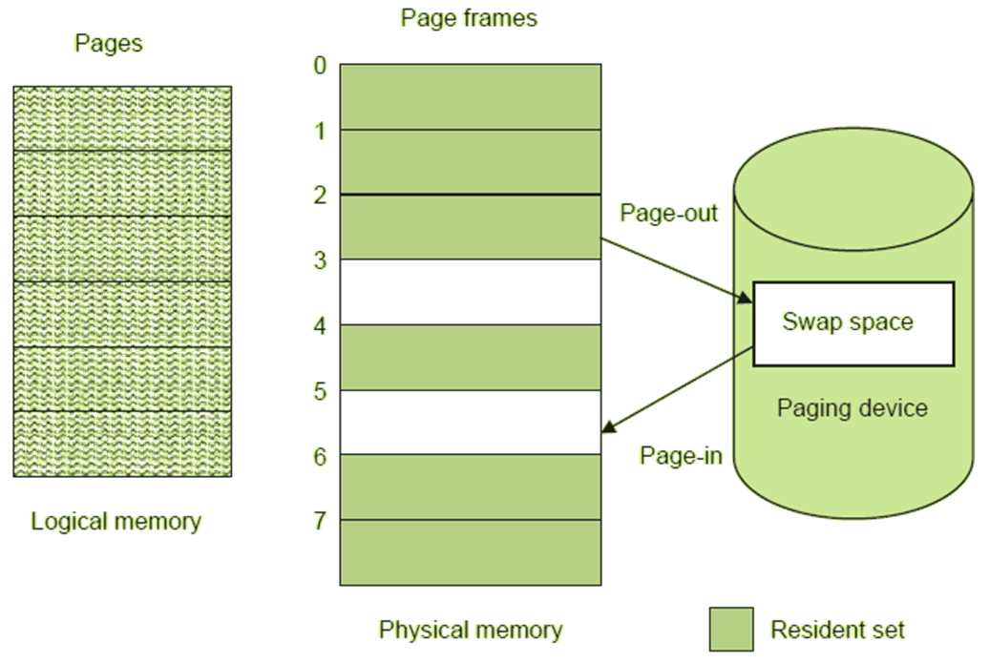
Demand paging

Slide 9
Page replacement algorithms
The strategy to choose a best page to be replaced in the memory is called a page replacement algorithm.
FIFO page replacement algorithm
A page to be replaced is chosen such that it is the oldest one among the all pages in the memory.
Optimal page replacement algorithm
A page will be replaced that will not be referenced for the longest time.

Slide 10
Page replacement algorithms
Least Recently Used (LRU) page replacement algorithm
Replace a page which will not be referenced for a longest time in the future.
Second chance page replacement algorithm
With the help of a reference bit with each page frame, an algorithm is designed to give a second chance to a page which is in use.

Slide 11
Page replacement algorithms
In other words, a page whose reference bit is 1, will not be replaced and given a second chance to be in the memory.
In this way, a page which is being frequently used but due to its arrival order as seen in FIFO, will not be replaced.
Clock page replacement algorithm
The implementation of second chance algorithm in the form of a queue may be inefficient as it incurs the cost of moving the pages with reference bit 1 at the end of the queue. Therefore, the pages are being moved around in the queue unnecessarily. A better approach for the implementation may be to have a circular queue instead of a general queue. The circular queue will store all the pages with their status bits as before.

Slide 12
Thrashing
The high paging activity is known as thrashing. A process is said to be thrashing if most of the time is being consumed in paging rather than its actual execution.

Slide 13
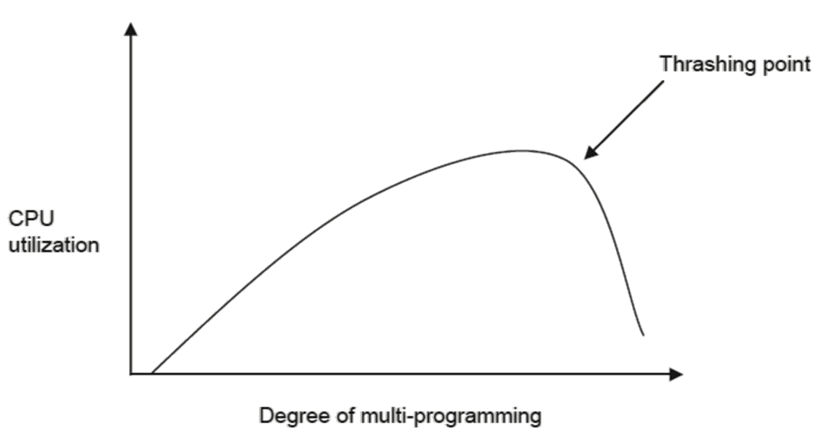
Thrashing

Slide 14
Combined paging and segmentation
Segments are partitioned into pages to have the benefits of both pure segmentation as well as pure paging. The idea of dividing the segments into pages is called paged segmentation system or combined paging/segmentation system which has been adopted in many significant operating systems.
In the combined segmentation/paging system, there is a segment table with each process as in pure segmentation but with many page tables because now every segment of the process consists of a page table. If a process has 5 segments, then this process has a segment table but consists of 5 page tables – one per segment. The virtual address in this system is of the following form:
(Segment number s, page number p, offset d)

Slide 15
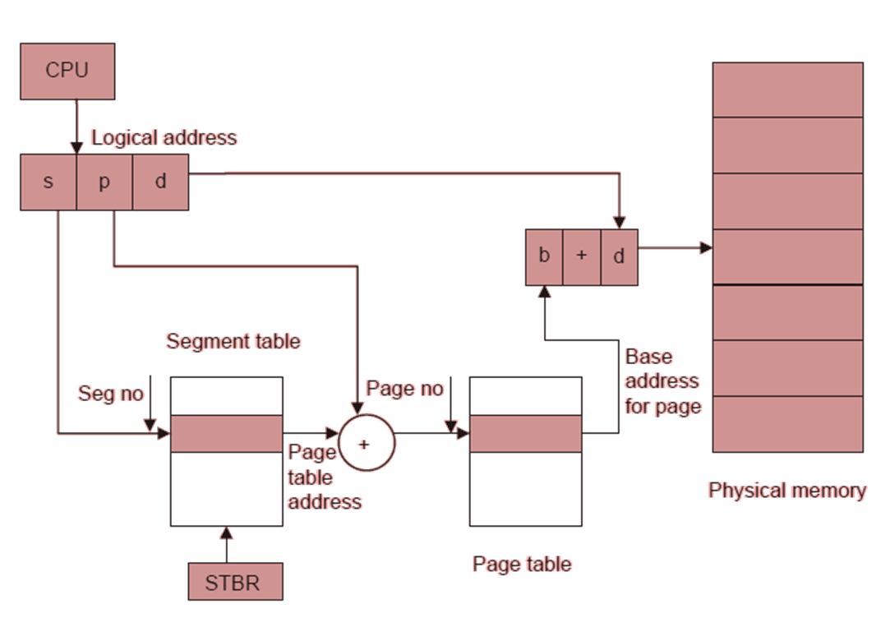
Address translation in paged segmentation

